Slide 1
Anxiety & Depression
Julianne Haddad

Slide 2
Presenter: Teen lifeline
https://teenlifeline.org/

Slide 3
Evolution of the human mind
Notes:
https://www.youtube.com/watch?v=kv6HkipQcfA

Slide 4
ANXIETY
In an anxiety-related disorder, your fear or worry does not go away and can get worse over time. It can influence your life to the extent that it can interfere with daily activities like school, work and/or relationships.
40 million Americans struggle with anxiety disorders

Slide 5
5 common types of anxiety disorders
Panic Disorder
Characterized by unpredictable panic attacks
Post-Traumatic Stress Disorder (PTSD)
can follow an exposure to a traumatic event
reliving of the traumatic event, avoidance behaviors and emotional numbing, and physiological arousal such as difficulty sleeping, irritability or poor concentration.
Social Phobia (or Social Anxiety Disorder)
Extreme anxiety about being judged by others or behaving in a way that might cause embarrassment or ridicule and may lead to avoidance behavior
Generalized Anxiety Disorder
persistent, irrational and extreme worry
Obsessive-Compulsive Disorder (OCD)
persistent, recurring thoughts (obsessions) and engage in compulsive ritualistic behaviors in order to reduce the anxiety associated with these obsessions (e.g. constant hand washing).
Notes:
This is not to be used to diagnose
If you believe you are experiencing one or more of these disorders talk with a doctor, therapist, or psychologist

Slide 6
Fight Flight Freeze Response
The fight-or-flight response, refers to a physiological reaction that occurs in the presence of something that is terrifying, either mentally or physically.
The response is triggered by the release of hormones that prepare your body to either stay and deal with a threat or to run away to safety
After the threat is gone, it takes between 20 to 60 minutes for the body to return to its pre-arousal levels.

Slide 7
Fight Flight Freeze Response

Slide 8
Grounding Exercise for Anxiety

Slide 9
Depression
Depression causes feelings of sadness and/or a loss of interest in activities once enjoyed. It can lead to a variety of emotional and physical problems and can decrease a person’s ability to function at work and at home.
3 million new cases per year
Feeling sad or having a depressed mood
Loss of interest or pleasure in activities once enjoyed
Changes in appetite — weight loss or gain unrelated to dieting
Trouble sleeping or sleeping too much
Loss of energy or increased fatigue
Increase in purposeless physical activity (e.g., hand-wringing or pacing) or slowed movements and speech (actions observable by others)
Feeling worthless or guilty
Difficulty thinking, concentrating or making decisions
Thoughts of death or suicide

Slide 10
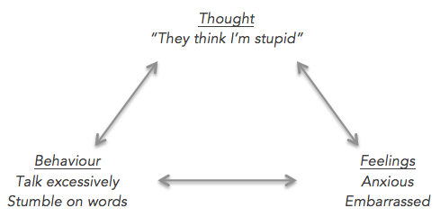
cbt

Slide 11
Worksheet activity

Slide 12
Diffusing your thoughts
Notes:
https://youtu.be/tzUoXJVI0wo

Slide 13
Good tips for dealing w/ anxiety and depression
Meditation
Healthy balanced diet (Protein, fruits, veggies, healthy fats)
Exercise!
Seek professional help (therapy, psychiatry, doctor, naturopathic doctor)
DON’T BE EMBARRESSED TO DO SO ☺
Self help books
Positive support system

Slide 14
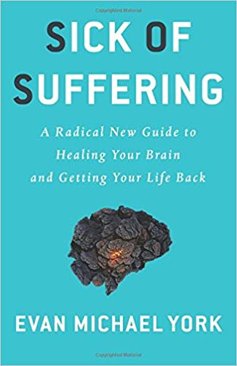
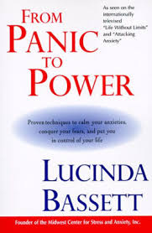
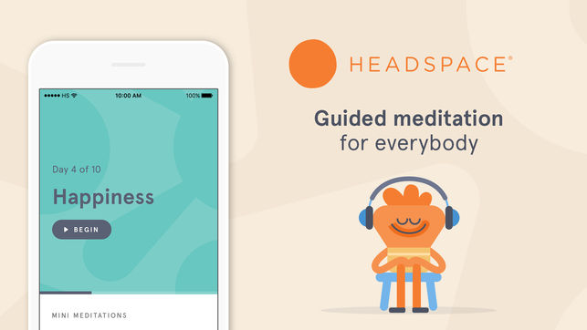
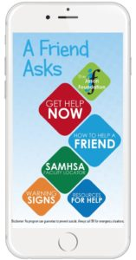
Books & Apps

